Slide 1
Chapter 2 Part III:
Project Scope Management

Slide 2
What is Project Scope Management?
Scope refers to all the work involved in creating the products of the project and the processes used to create them. It defines what is or is not to be done
Deliverables are products produced as part of a project, such as hardware or software, planning documents, or meeting minutes
The project team and stakeholders must have the same understanding of what products will be produced as a result of a project and how they’ll be produced

Slide 3
Project Scope Management Processes
Initiation: beginning a project or continuing to the next phase
Scope planning: developing documents to provide the basis for future project decisions
Scope definition: subdividing the major project deliverables into smaller, more manageable components
Scope verification: formalizing acceptance of the project scope
Scope change control: controlling changes to project scope

Slide 4
Project Initiation: Strategic Planning and Project Selection
The first step in initiating projects is to look at the big picture or strategic plan of an organization
Strategic planning involves determining long-term business objectives
IT projects should support strategic and financial business objectives

Slide 5
Identifying Potential Projects
Many organizations follow a planning process for selecting IT projects
First develop an IT strategic plan based on the organization’s overall strategic plan
Then perform a business area analysis
Then define potential projects
Then select IT projects and assign resources

Slide 6
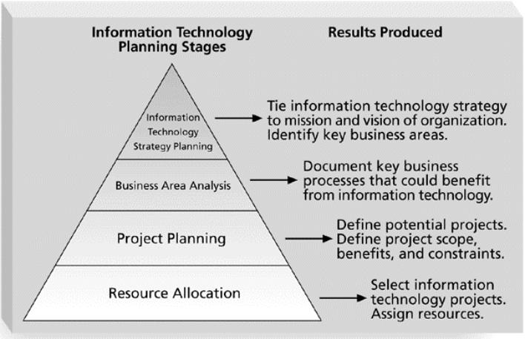
Figure 5-1. Information Technology Planning Process

Slide 7
Methods for Selecting Projects
There are usually more projects than available time and resources to implement them
It is important to follow a logical process for selecting IT projects to work on
Methods include:
  focusing on broad needs
  categorizing projects
  performing financial analyses
  using a weighted scoring model
  implementing a balanced scorecard

Slide 8
Focusing on Broad
Organizational Needs
It is often difficult to provide strong justification for many IT projects, but everyone agrees they have a high value
“It is better to measure gold roughly than to count pennies precisely”
Three important criteria for projects:
  There is a need for the project
  There are funds available
  There’s a strong will to make the project succeed

Slide 9
Categorizing IT Projects
One categorization is whether the project addresses
  a problem
  an opportunity
  a directive
Another categorization is how long it will take to do and when it is needed
Another is the overall priority of the project

Slide 10
Project Charters
After deciding what project to work on, it is important to formalize projects
A project charter is a document that formally recognizes the existence of a project and provides direction on the project’s objectives and management
Key psign a project charterroject stakeholders should to acknowledge agreement on the need and intent of the project

Slide 11
Scope Planning and the
Scope Statement
A scope statement is a document used to develop and confirm a common understanding of the project scope. It should include
  a project justification
  a brief description of the project’s products
  a summary of all project deliverables
  a statement of what determines project success

Slide 12
Scope Planning and the Work Breakdown Structure
After completing scope planning, the next step is to further define the work by breaking it into manageable pieces
Good scope definition
  helps improve the accuracy of time, cost, and resource estimates
  defines a baseline for performance measurement and project control
  aids in communicating clear work responsibilities

Slide 13
The Work Breakdown Structure
A work breakdown structure (WBS) is a deliverable-oriented grouping of the work involved in a project that defines the total scope of the project
It is a foundation document in project management because it provides the basis for planning and managing project schedules, costs, and changes

Slide 14
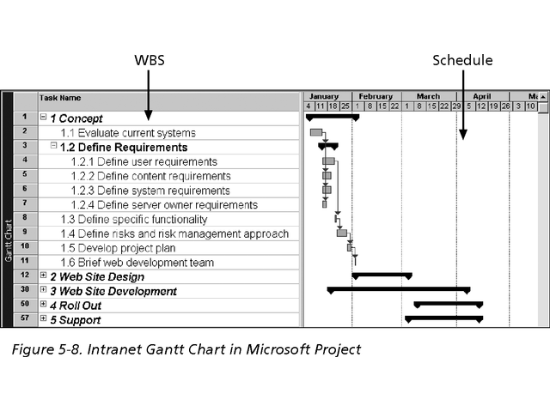
Figure 5-8. Intranet WBS and Gantt Chart in Project 2000

Slide 15
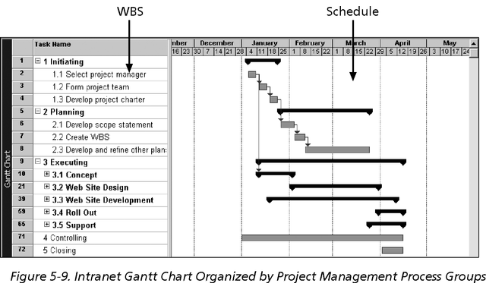
Figure 5-9. Intranet WBS and Gantt Chart Organized by Project Management Process Groups

Slide 16
Approaches to Developing WBSs
Using guidelines: Some organizations, provide guidelines for preparing WBSs
The analogy approach: Review WBSs of similar projects and tailor to your project
The top-down approach: Start with the largest items of the project and break them down
The bottom-up approach: Start with the detailed tasks and roll them up
Mind-mapping approach: Write down tasks in a non-linear format and then create the WBS structure

Slide 17
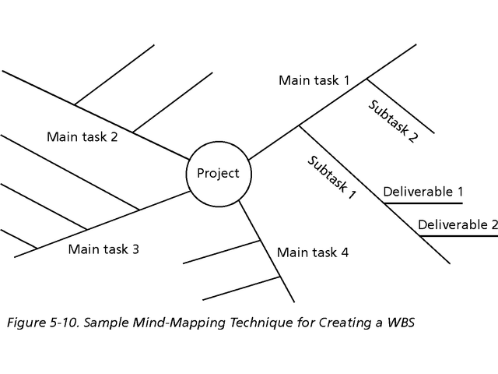
Sample Mind-Mapping Approach

Slide 18
Scope Verification and Scope Change Control
It is very difficult to create a good scope statement and WBS for a project
It is even more difficult to verify project scope and minimize scope changes
Many IT projects suffer from scope creep and poor scope verification
  FoxMeyer Drug filed for bankruptcy after scope creep on a robotic warehouse
  Engineers at Grumman called a system “Naziware” and refused to use it
  21st Century Insurance Group wasted a lot of time and money on a project that could have used off-the-shelf components

Slide 19
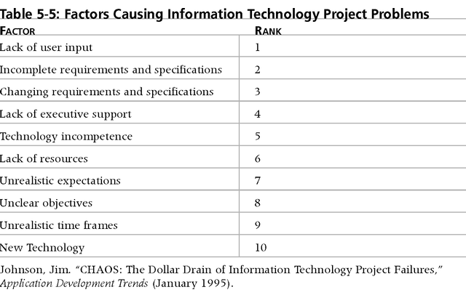
Factors Causing IT Project Problems

Slide 20
Suggestions for Improving User Input
Develop a good project selection process and insist that sponsors are from the user organization
Have users on the project team in important roles
Have regular meetings
Deliver something to users and sponsors on a regular basis
Co-locate users with developers

Slide 21
Suggestions for Reducing Incomplete and Changing Requirements
Develop and follow a requirements management process
Use techniques like prototyping, use case modeling, and JAD to get more user involvement
Put requirements in writing and keep them current
Provide adequate testing and conduct testing throughout the project life cycle
Review changes from a systems perspective
Emphasize completion dates to help focus on what’s most important
Allocate resources specifically for handling change requests/enhancements.

Slide 22
Finally
  Exploration of project management software, e.g.
    Microsoft Project
    Rational Requisite Pro
    Clear Case
      etc

Slide 23
Group Assignment
1. project human resource management
2. project cost management
3. project risk management
4. project quality management

